Slide 1




Analyzing Detroit Crime with the
Lions

Slide 2
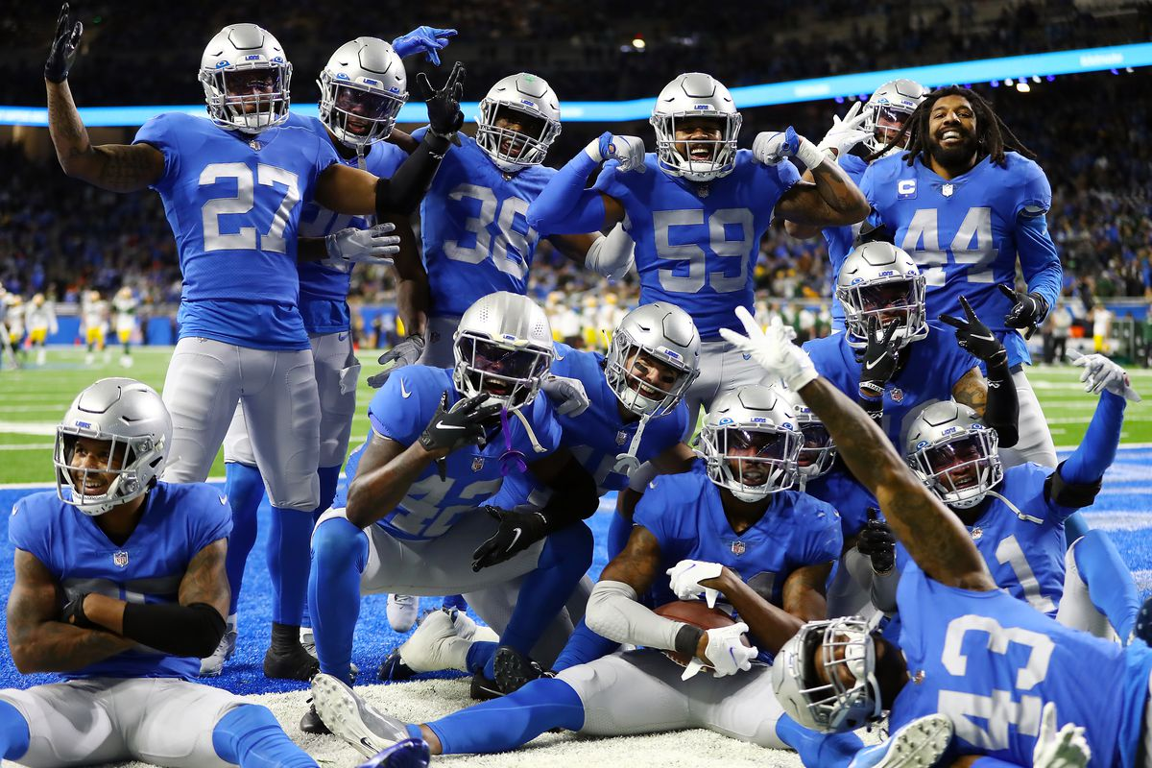
Agenda
Topics Covered
Business Question
Data Sources / Approach
Visuals / Findings
Learnings
Wrap Up

Slide 3



Question to explore
How do NFL game days affect the crime incident frequency
within the team’s home geographic region?
Who Cares?
Government Agencies that oversee DPD
Additional Stakeholders: Citizens & Healthcare Providers
Data
API: Sportsradar
Dataset: Detroit Police Department
(DPD)

Slide 4

Data Sources
Sportsradar API
DPD
NFL Team:
Detroit Lions
2022 Home and Away Games (17 total)
Crime Incidents from 2016-2023
Filtered by zip code, description & time of year
*explained on next slide

Slide 5
Data Source Process
Sportsradar API
DPD
Goal: Extract game date & time, home/away, game result, and final
points scored
Challenges: Complex data structure with multiple nested dictionaries
Process: Python (Extracting Data by season and exploring relationships and patterns using preliminary graphs)
Goal: Determine patterns of crime and establish a control variable
Challenges: Incident Description Variations, Crime Seasonality, Geographic Spread
Process: 1. SQL (filter out irrelevant columns and dates) and 2. Python (mapping crime variations to standardized names)

Slide 6
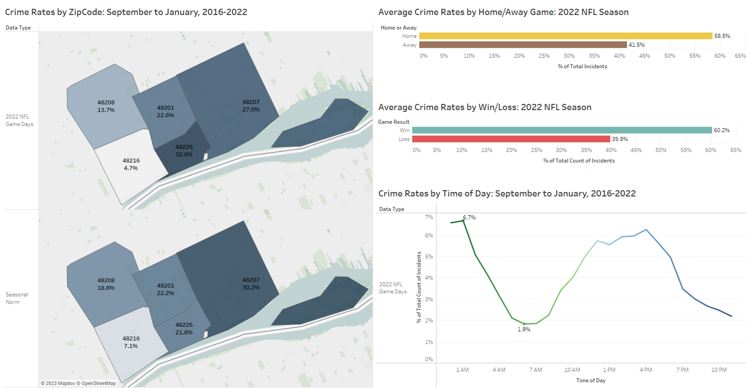
Dashboard
Findings
Increased incident rates around Ford Field Stadium on game day
Higher number of incidents post-game
Wins and home games result in increased crime activities

Slide 7
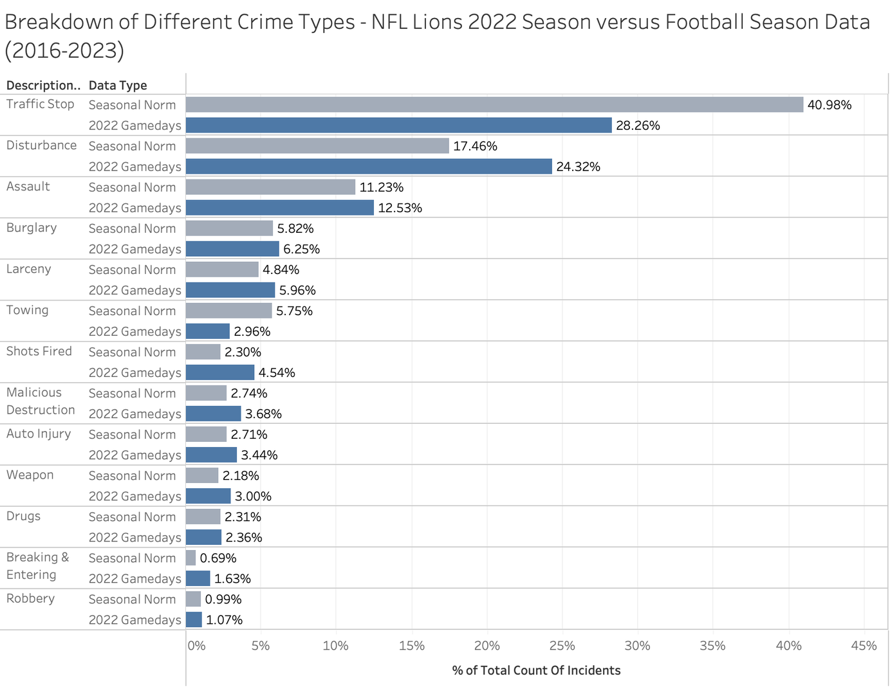
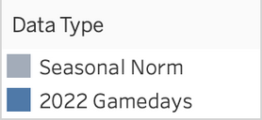
Breakdown of Different Crime Types -
NFL Lions 2022 Season vs. 2016 - 2023 Seasonal Data
Crime
Breakdown

Slide 8
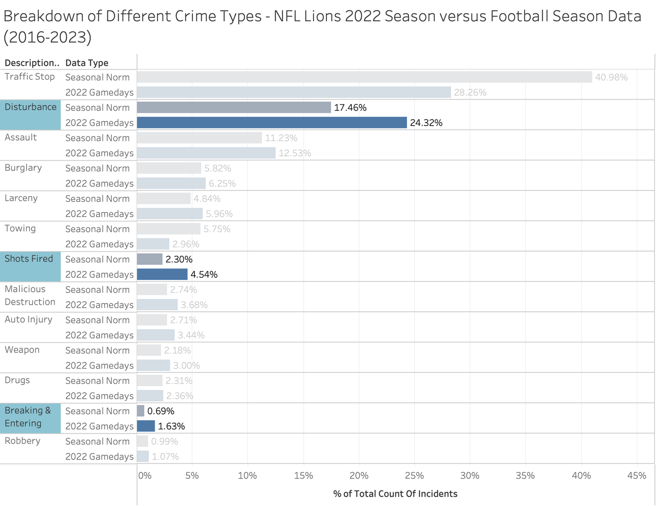
Breakdown of Different Crime Types -
NFL Lions 2022 Season vs. 2016 - 2023 Seasonal Data
Findings
Traffic Stops & Towing decreased
All incident types increased
Disturbances up 6.86%
Shots Fired and Breaking & Entering roughly doubled

Slide 9
Takeaways
Government Agencies
GAME DAY : Deploying additional officers past 10pm (timing spike) + move officers to 48226
Are there patterns of crime relating to time, type, and neighborhood location that the police department should be aware of to better schedule their resources?
PREVENTATIVE : Home/Away (increased crime rates for home games) and Win/Loss plan (additional resources/personnel on standby)
BY CRIME TYPE: Enhanced surveillance and rapid response vs. ticketing/auto monitoring
Other Stakeholders
CITIZENS: Heightened awareness and personal security measures before game (during peak hours)
HEALTHCARE: Emergency personnel and resources near Ford Field

Slide 10

Future Considerations:
Explore response times & priority... could optimize prioritization processes
Look at other NFL teams in respective city
Additional datasets - obtain DPD staffing information (officer count / schedules)
THANK YOU! Q & A

